Slide 1

Grace & Grit
in uncertain times

Slide 2

Notes:
Nora

Slide 3
Piper, Pixar (2016)
What did the video make you think about?
1
How did the video make you feel?
2
What does the video make you want to do more or less of?
3
Notes:
Nora

Slide 4
GRIT IS… (Angela Duckworth)
Passion
Perseverance
Long-Term Goals
Notes:
Nora

Slide 5
GRIT IS…
An ”ultimate concern” - a goal you care about so much that it organizes and gives meaning to almost everything you do.
Holding steadfast to that goal - even when you fall down, screw up, and don’t know what to do.
Notes:
Nora

Slide 6
GRIT IS NOT…
Talent (rate at which a person improves in skill)
Luck (right place, right time)
Intensity (charisma)
Desire (aspirations)
Notes:
Nora

Slide 7


Grit is the
Grace-filled,
Rest-fueled
Investment in
Trusting
God’s preferred future.
Notes:
Nora

Slide 8

Grit is a whole lot more about culture than it is about strategy.
Notes:
Tim

Slide 9
Grit is first about who You are and who you are becoming.
Notes:
Tim

Slide 10
We are all caught up in our own histories.
Jack Miezerow transformational dimensions of adult learning
Notes:
Tim

Slide 11

“The more deeply a thought or action is tied to your identity, the more difficult it is to change it…
The biggest barrier to positive change at any level—individual, team, society—is identity conflict.
Good habits can make rational sense, but if they conflict with your identity, you will fail to put them into action.”
James CLEAR, Atomic Habits
Notes:
Tim

Slide 12
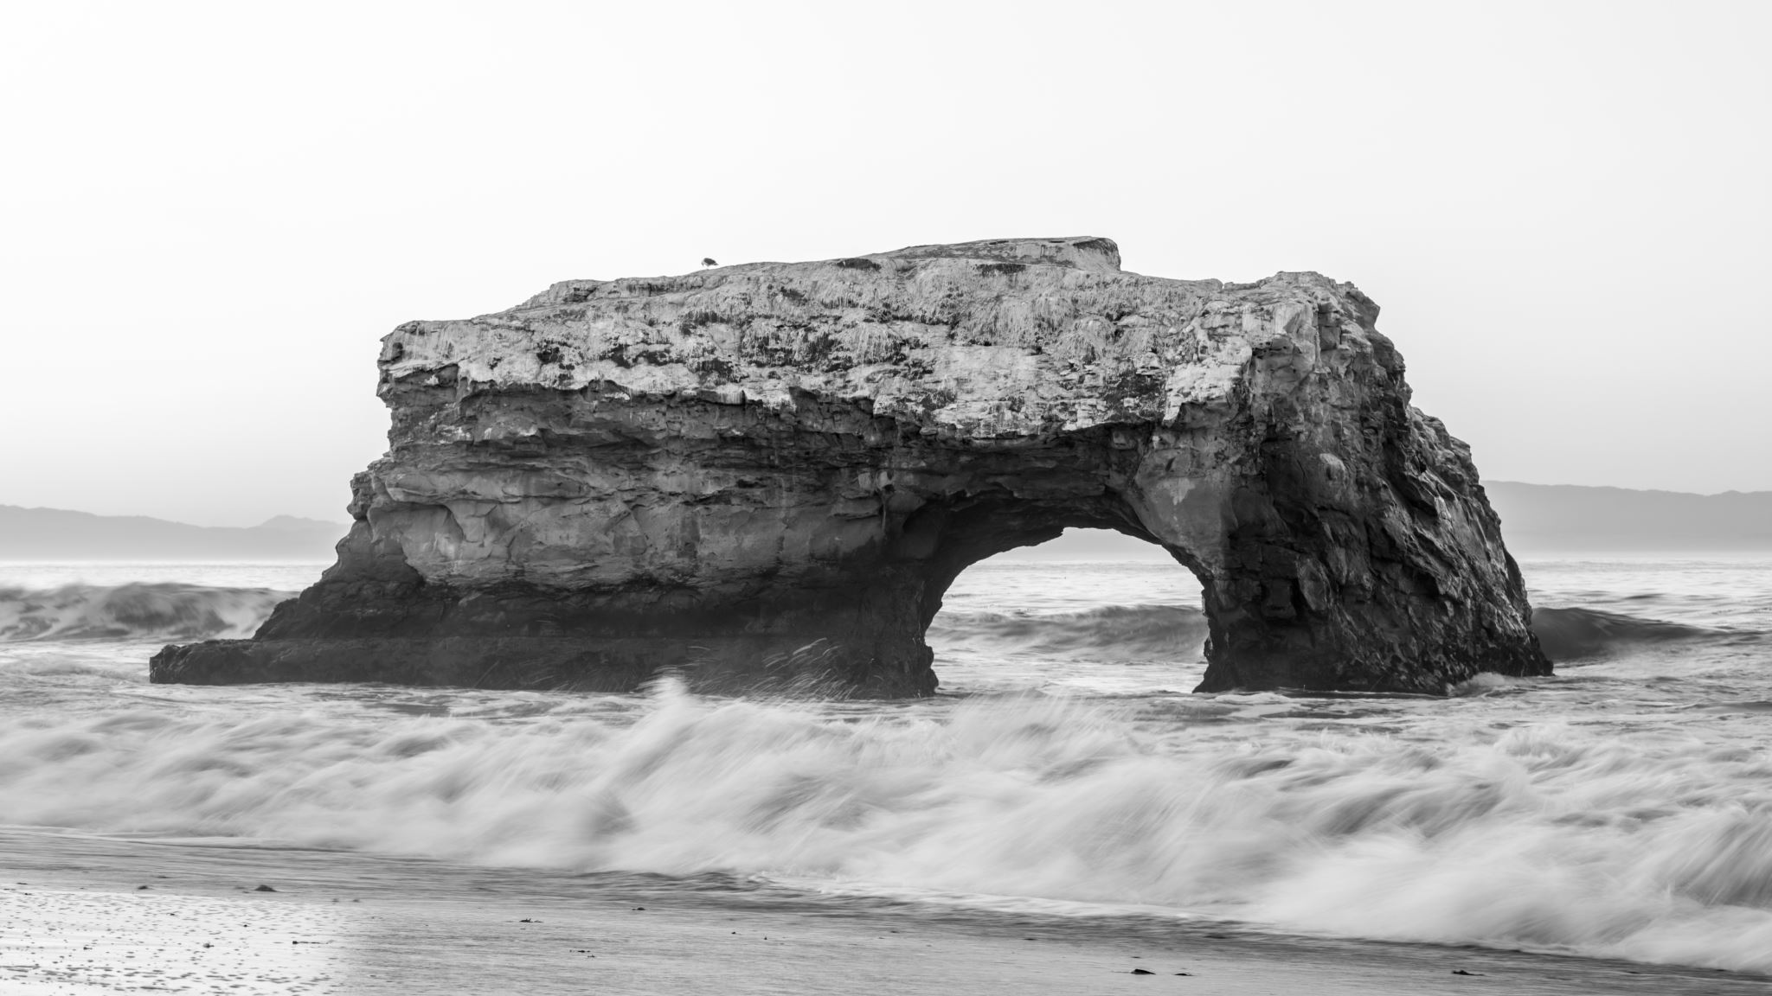
Grace
Notes:
Tim

Slide 13
So goes the leader, so goes the culture.
So goes the culture, so goes the company.
SIMON SINEK
Notes:
Tim

Slide 14
Where do you need to grow in grace as a leader?
Volunteers & Church Leaders
Lack of Participation
Unresponsiveness of People
Prickly Parents (People)
Decisions have been needed to be made very quickly.
Second guessing happens almost immediately.
Notes:
Nora

Slide 15
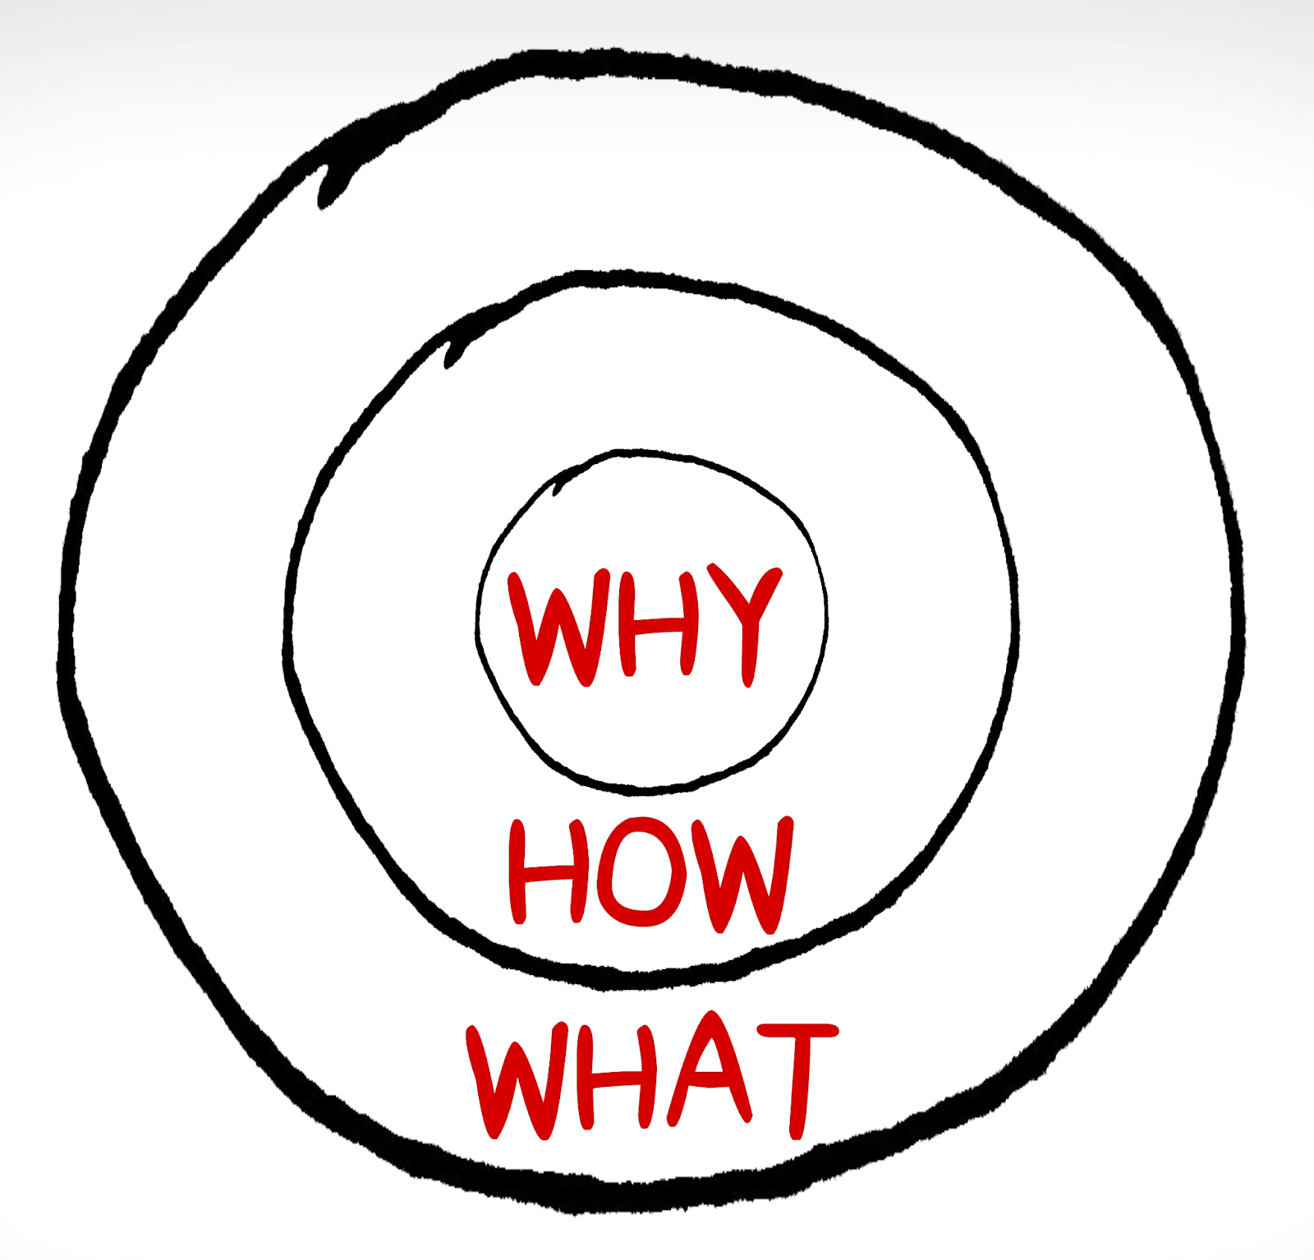
IF EVERYBODY IS MANAGING, NOBODY IS LEADING.
Why?
We believe in the transformational power of the love of Jesus which is experienced through ordinary people, it changes how we feel, think, and live.
How?
We create, facilitate, and support relationships and experiences where people can love God, love people, and live like Jesus.
What?
We have a digital space (Online Campus) where people can gather, connect, and serve.
Notes:
Tim

Slide 16
At our savior…
“The What” is always adapting
while we are…
Rooted on what Jesus is doing (the why)
Centered in Jesus’ Mission (our how)
Making disciples who love God, love people, and live like Jesus.
Being in a personal relationship with Jesus
True to God’s Word; God’s Word is true
Making truth relevant
Living life on mission
Living generously
Fostering a culture of care and belonging
Notes:
Tim

Slide 17
Control The controllables
What do we need to stop doing so that we can join Jesus on His mission?
What is good? Better? Best? (Not perfection)
What is the priority today?
What is the “One Thing” we are asking people to consider?
It’s about leading people to take their next steps.
Notes:
Tim

Slide 18

Rest & Renewal
Notes:
Tim

Slide 19
“We have not been directly exposed to the trauma scene, but we hear the story told with such intensity, or we hear similar stories so often, or we have the gift and curse of extreme empathy and we suffer. We feel the feelings of our clients. We experience their fears. We dream their dreams. Eventually, we lose a certain spark of optimism, humor and hope. We tire. We aren’t sick, but we aren’t ourselves.”
Charles Figley, 1995
Notes:
Tim

Slide 20
Compassion Fatigue is different from burnout.
Burnout is a state of emotional, mental, and often physical exhaustion brought on by prolonged or repeated stress.
Burnout is NOT trauma-related.
Psychology today
Notes:
Tim

Slide 21
Prioritize: Is the juice worth the squeeze?
Saying no to ‘good’ for god’s ‘best’
Healthy you. Healthy us.
Flexible work schedules
Flexible PTO
Pace
Team Bonding
Team Retreats
Practices
Daily Prayer
Weekly Devotions
Ensure vacation time
Kick people out of the office
Counseling Services
Mental Health First Aid Training
Notes:
Nora

Slide 22
What makes rest uncertain?
What moves us toward rest?
Lack of outreach
COVID has become an excuse to never come to worship nor be involved
Having a child with COVID while out of town. I am overwhelmed.
Church leaders openly speaking badly about members
Feeling burned out and depressed.
Changes in personal life.
Being tired and not having the mental and emotional energy to invest as deeply as I did when I began
Not having enough energy to do “all the things”
Dealing with depression and an adult son whose life is off the rails
Notes:
Nora

Slide 23
Control The controllables
What do we need to stop doing so that we can join Jesus on His mission?
What is good? Better? Best? (Not perfection)
What is the priority today?
What is the “One Thing” we are asking people to consider?
It’s about leading people to take their next steps.
Notes:
Nora

Slide 24

Investing in relationships

Slide 25
Relationships are King.
How are you loving your person – not your issue
(or theirs)?
Love your person. Not your issue.
Theological Position
Practices
Mask Mandates
Vaccination Mandates
Diversity, Equity, and Inclusion (DEI)
Race/CRT
LGBTQ+
Economics/Inflation
What vehicle is love driving today?
Physical Vehicles
Digital Vehicles
Notes:
Tim

Slide 26
What brings tension to friendship?
Feeling pressure to agree with political opinions as a matter of Christian unity.
Sustainability, comfortable with traditions, maintaining, many missional activities, no uniting ministry
COVID and people’s varied reaction to it
Women in Leadership
Notes:
Nora

Slide 27
We live in a phygital world.
Jesus is already there.
The church needs to move in.
Notes:
Tim

Slide 28
TRUST

Slide 29
Changing the focus:
What’s the worst that can happen?
Lower Giving
Reductions in Force
”Wrong” Personality
Not equipped to be a “missionary
Not prepared for leading a large school as a first-time principal
Being thought of as a “know it all”
Tension between what I feel will produce a “successful” ministry and casting vision effectively.
People moving away and a dip in tithing
Notes:
Nora

Slide 30
Changing the focus:
What’s the best that can happen?
Mental Health First Aid
Digital Discipleship
Online Minister
Seasonal & Year-Round Interns
Kids Ministry Shift
Salary Restructure
Went from 3 Good Services to 2 Great Services
Serving Events to Quarterly
Student Camp to Family Camp
Stopped Student Sundays
Started Youth Life Groups
Outdoor Cafe
Aligned Joy of Generosity
Conversations Groups (Race, Culture)
Notes:
Tim

Slide 31
GRIT helps us Look Forward:
Rebuilding Cities; Restoring Homes
  Online Campus
  Plant Life Groups in New Neighborhoods
  Keychain Leadership
  “One Thing” Community Events
  Celebrate Volunteers & Partnerships Well
  Community Resource Center
  Community Services for Mental Wellness
  Early Childhood Center
  Community Café
  Premier Community for the Performing Arts
  Resource & Network Nonprofits, Networks, Leaders & Churches
Notes:
Tim

Slide 32
GRIT IS… (Angela Duckworth)
Passion
Perseverance
Long-Term Goals
Notes:
Tim

Slide 33
Grit is the
Grace-filled,
Rest-fueled
Investment in
Trusting
God’s preferred future.
Notes:
Nora

Slide 34
Grit is a whole lot more about culture than it is about strategy.
Notes:
Tim

Slide 35
Grit is first about who You are and who you are becoming.
Notes:
Tim

Slide 36
More conversation
Nora gass – nora@oslc.com
Tim Bayer – Pastortim@oslc.com
Facebook: tim.bayer2
Instagram: timbayer
Notes:
Tim

Slide 37
Grace & Grit
in uncertain times

